Slide 1
Improving the coherence time of superconducting qubits by design
A procedure to calculate participation ratios
Notes:
In my search to increase the coherence time of transmon qubits I have focused on one specific source of decoherence. Namely the two-level systems in lossy layers.

Slide 2
Sources of decoherence
A prominent source of decoherence are two-level states (TLS) on various surfaces.
Layers containing a high concentration of TLSs are created during production of the qubit.
These are the “lossy-layers”.
Notes:
These layers containing two-level systems are a prominent source of decoherence, if not a limiting factor to the coherence time of qubits.

Slide 3
Lossy layers
3 lossy-layers are considered:
Metal-Vacuum interface (MV)
Metal-Substrate interface (MS)
Substrate-Vacuum (SV)
Notes:
I my simulations I have considered three different lossy layers. They are created during different production steps and therefore have a different composition.

Slide 4
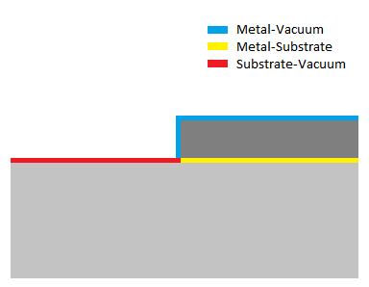
Lossy layers

Slide 5
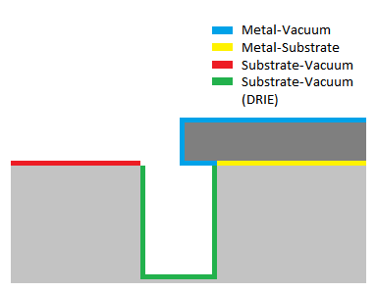
Lossy layers

Slide 6
Lossy layers
Lossy layers have a relatively small thickness of ~3nm
High density of TLSs inducing significant dissipation of energy
Notes:
Although the lossy layers are considered to have a relatively small thickness of 3nm compared to the thickness of the pads of 100nm it is the high density of two-level systems the that make the dissipation of energy significant in these layers.

Slide 7
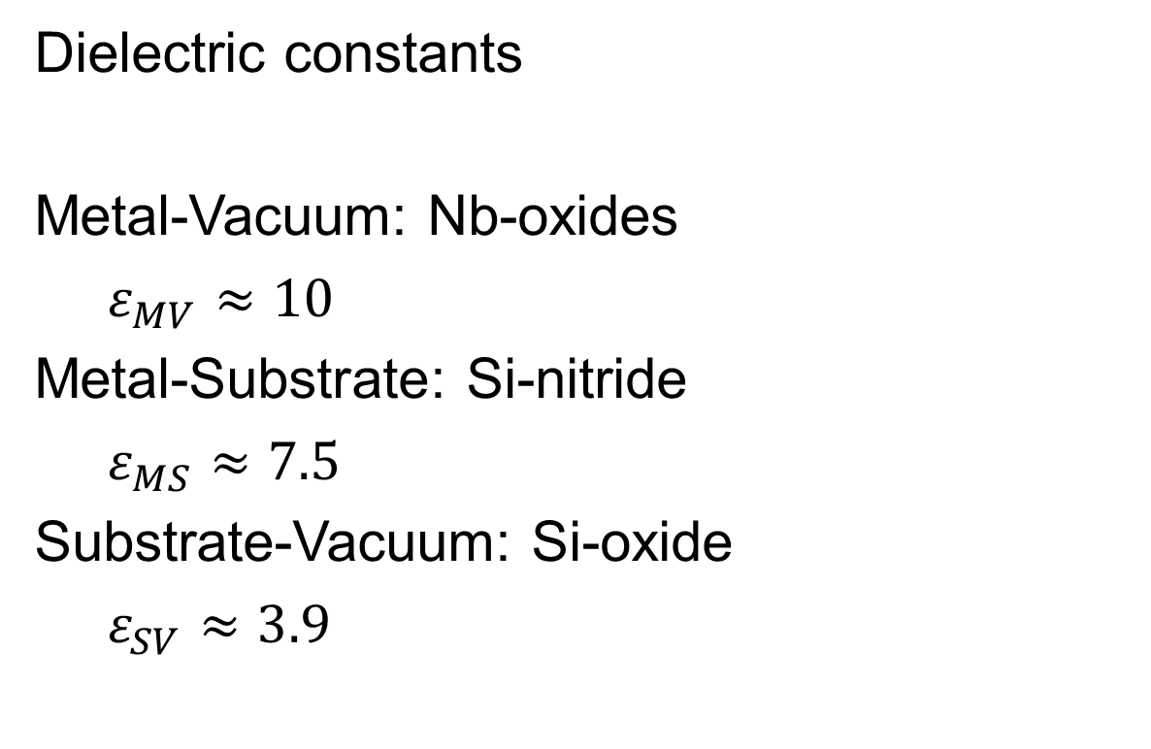
Lossy layers
Dielectric constants
Metal-Vacuum: Nb-oxides
$ε_{MV}≈10$
Metal-Substrate: Si-nitride
$ε_{MS}≈7.5$
Substrate-Vacuum: Si-oxide
$ε_{SV}≈3.9$

Slide 8
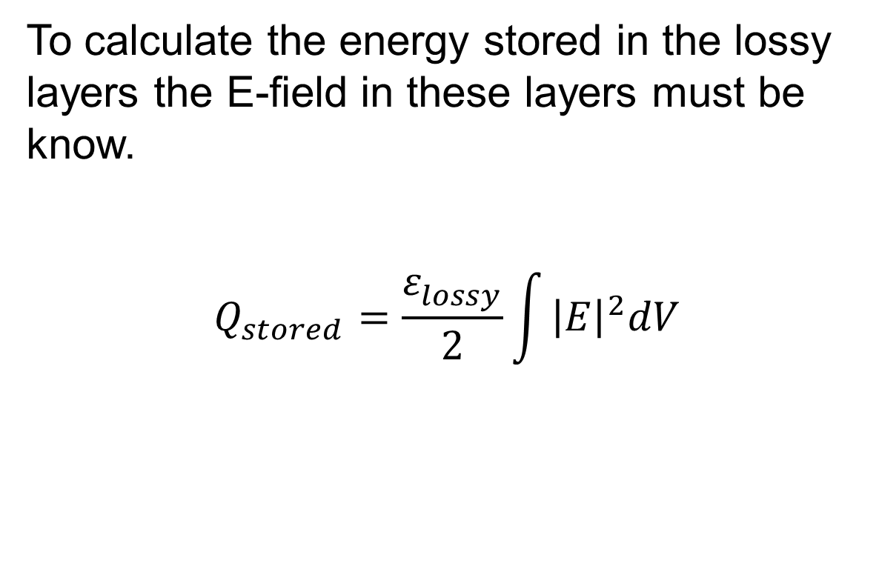
Model of the system
To calculate the energy stored in the lossy layers the E-field in these layers must be know.
$$Q_{stored}=\frac{ε_{lossy}^{}}{2}\int{{\left|E\right|}^{2}dV}$$

Slide 9
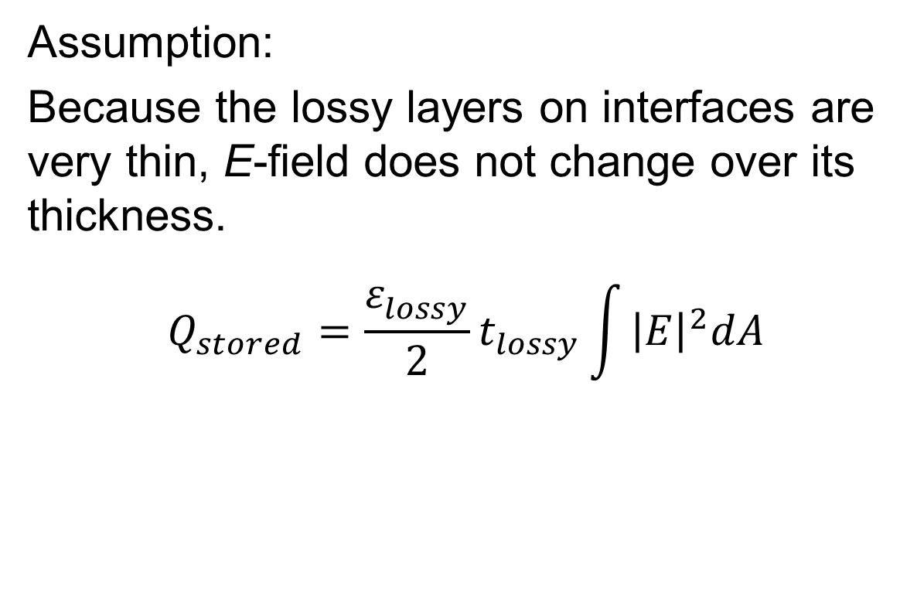
Model of the system
Assumption:
Because the lossy layers on interfaces are very thin, E-field does not change over its thickness.
$$Q_{stored}=\frac{ε_{lossy}^{}}{2}t_{lossy}\int{{\left|E\right|}^{2}dA}$$
Notes:
Because the lossy layers are so thin compared to the rest of the system it would be undoable to consider them during the simulation in CST. Therefore the assumption is made that the lossy layers do not change the electric field.

Slide 10
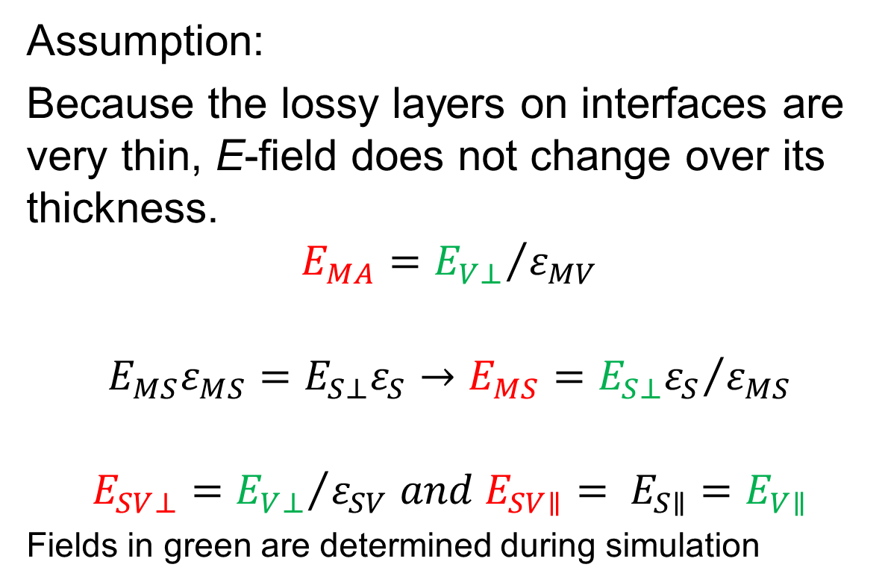
Model of the system
Assumption:
Because the lossy layers on interfaces are very thin, E-field does not change over its thickness.
$$E_{MA}={E_{V⊥}}/{ε_{MV}}$$
$$E_{MS}ε_{MS}=E_{S⊥}ε_{S}→E_{MS}={E_{S⊥}ε_{S}}/{ε_{MS}}$$
$$E_{SV⊥}={E_{V⊥}}/{ε_{SV} and E_{SV∥}= E_{S∥}{=E}_{V∥}}$$
Fields in green are determined during simulation
Notes:
Having made this assumption for the simulation of the qubit it is still necessary to consider the difference in dielectric constants. The amplitude of the field inside the areas containing lossy material is changed accordingly.

Slide 11
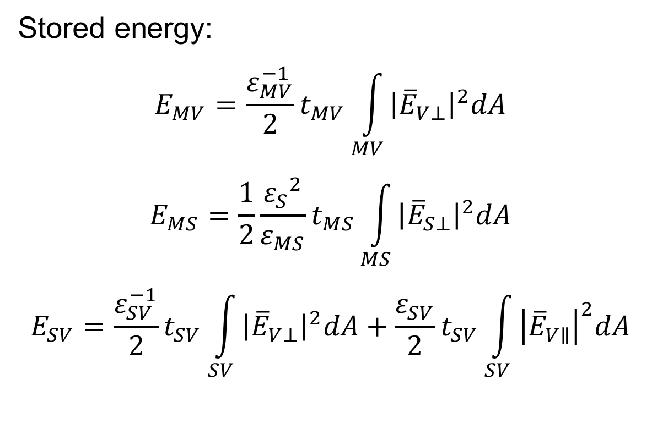
Model of the system
Stored energy:
$$E_{MV}=\frac{ε_{MV}^{−1}}{2}t_{MV}\int_{MV}{{\left|{\overline{E}}_{V⊥}\right|}^{2}dA}$$
$$E_{MS}=\frac{1}{2}\frac{{ε_{S}}^{2}}{ε_{MS}}t_{MS}\int_{MS}{{\left|{\overline{E}}_{S⊥}\right|}^{2}dA}$$
$$E_{SV}=\frac{ε_{SV}^{−1}}{2}t_{SV}\int_{SV}{{\left|{\overline{E}}_{V⊥}\right|}^{2}dA}+\frac{ε_{SV}^{}}{2}t_{SV}\int_{SV}{{\left|{\overline{E}}_{V∥}\right|}^{2}dA}$$
Notes:
https://farside.ph.utexas.edu/teaching/jk1/lectures/node112.html
https://books.google.nl/books?id=mll47bVO29gC&pg=PA1415&lpg=PA1415&dq=tangential+electric+field+superconductor+high+frequency&source=bl&ots=CdOO-SKSTM&sig=WD6728zQIlr839oagMkSicv-3ps&hl=en&sa=X&ved=0ahUKEwiHlOG34YLNAhWKKcAKHbGSDBAQ6AEIKTAB#v=onepage&q=tangential%20electric%20field%20superconductor%20high%20frequency&f=false

Slide 12
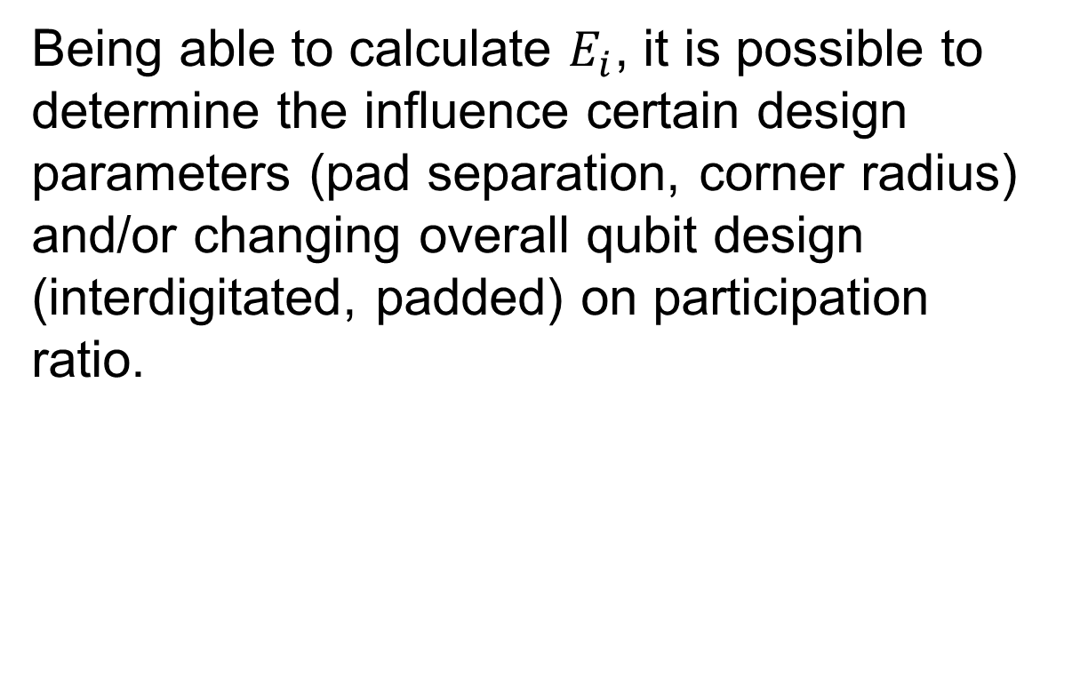
Model of the system
Being able to calculate $E_{i}$, it is possible to determine the influence certain design parameters (pad separation, corner radius) and/or changing overall qubit design (interdigitated, padded) on participation ratio.

Slide 13
Simulation

Slide 14
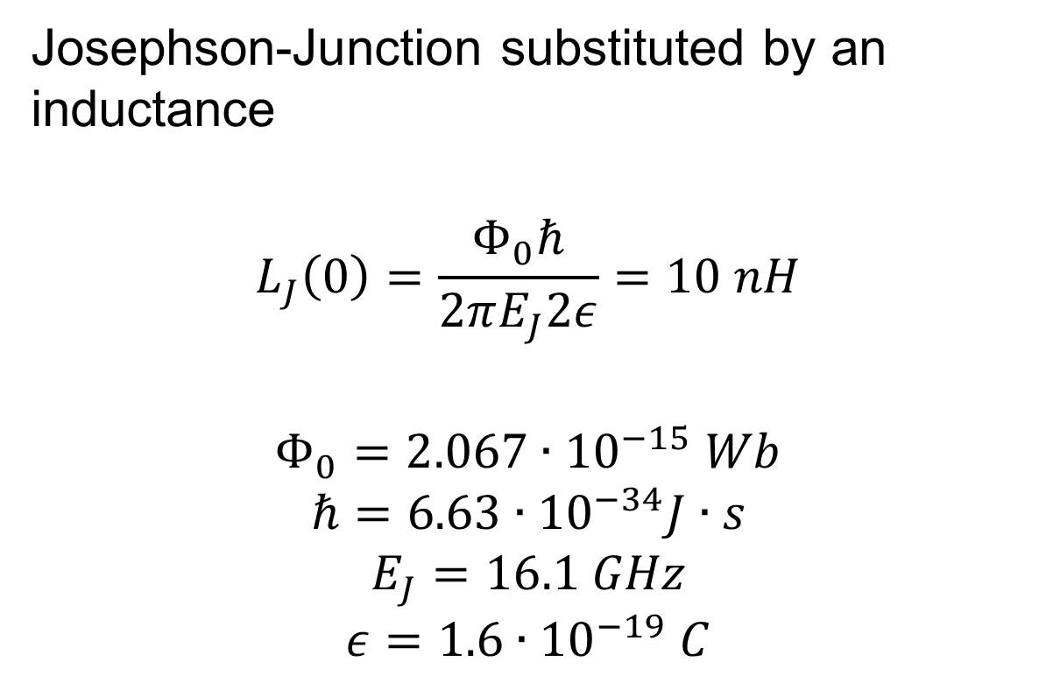
Simulation - Setup
Josephson-Junction substituted by an inductance
$$L_{J}\left(0\right)=\frac{Φ_{0}ℏ}{2πE_{J}2ε}=10 nH$$
$$Φ_{0}=2.067∙{10}^{−15} Wb$$
$$ℏ=6.63∙{10}^{−34}J∙s$$
$$E_{J}=16.1 GHz$$
$$ε=1.6∙{10}^{−19} C$$
Notes:
E = h*v
hbar = h/2pi

Slide 15
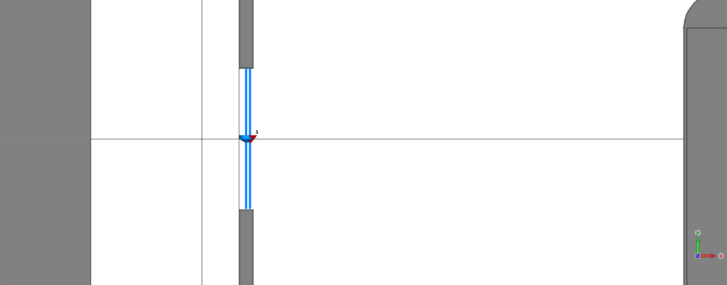
Simulation - Setup
Josephson-Junction substituted by an inductance

Slide 16
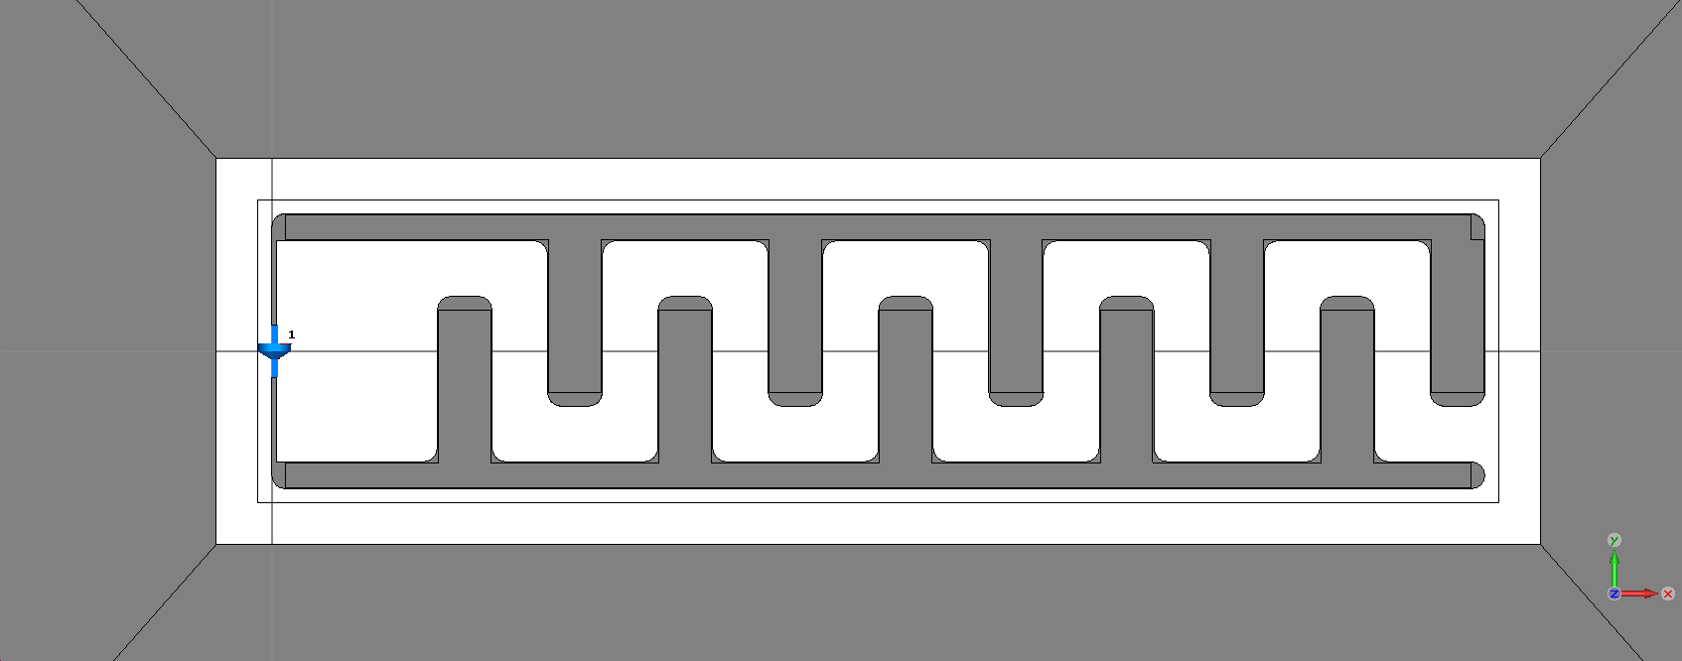
Simulation - Setup
Pads

Slide 17
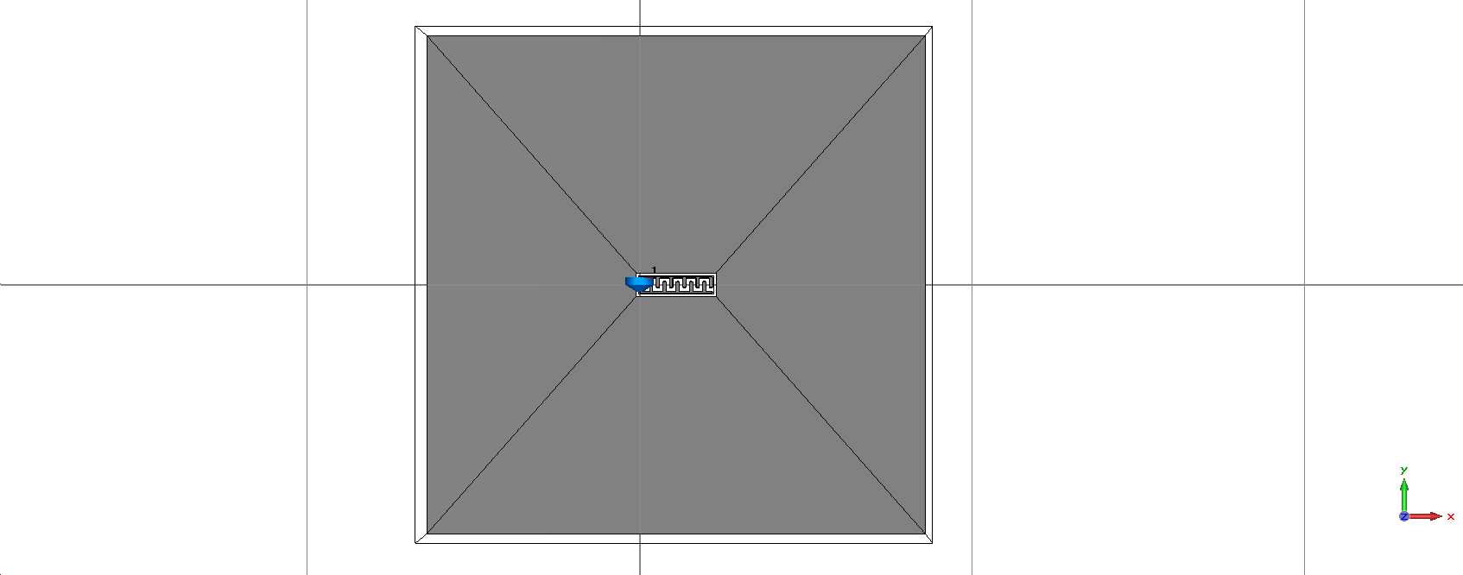
Simulation - Setup
Ground

Slide 18
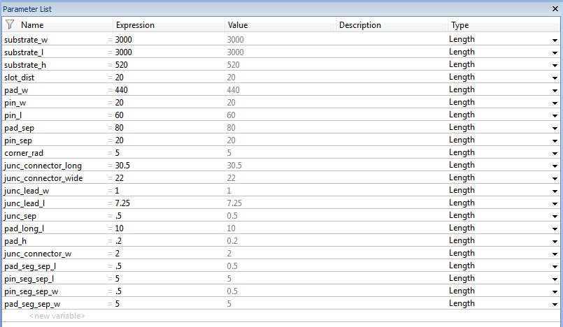
Simulation - Setup
Parametrized

Slide 19
Simulation - Meshing
The initial mesh is a critical factor in reducing simulation time and improving results.
Create fine mesh only at important surfaces
Eliminate Low Quality Mesh Elements
Keep the total amount of mesh elements as low as possible.

Slide 20
Simulation - Meshing
Divide pads in (several) segments
Adjust maximum mesh size for each segment. Segments closer to edges receive lower maximum.
This creates a fine mesh without adding unnecessary mesh elements.

Slide 21
Simulation - Meshing
Creating a fine mesh near the edge of the pad simultaneously eliminates most low quality mesh elements.

Slide 22
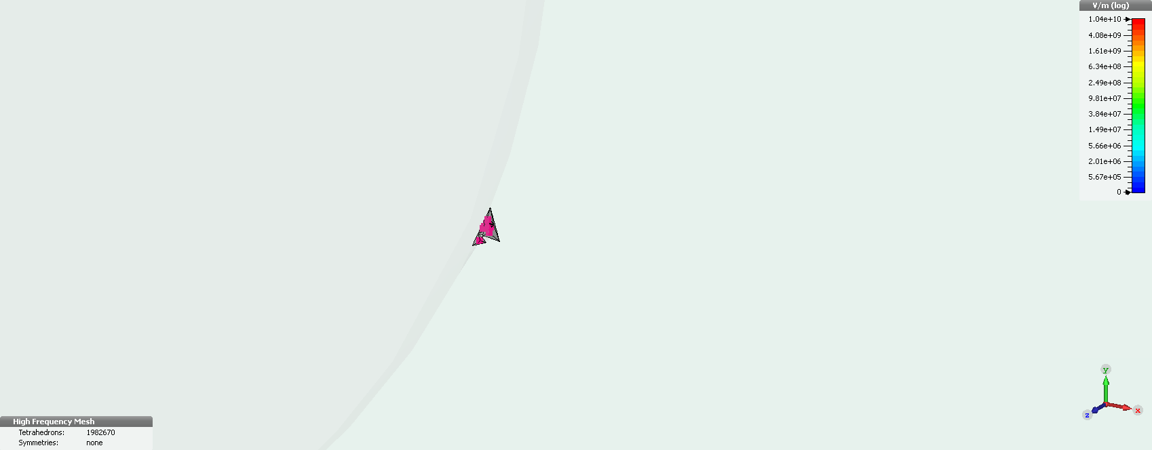
Simulation - Meshing

Slide 23
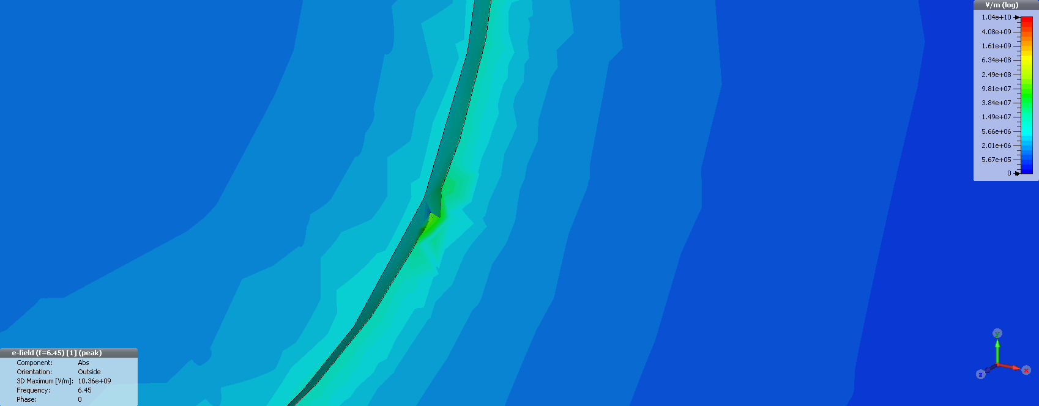
Simulation - Meshing

Slide 24
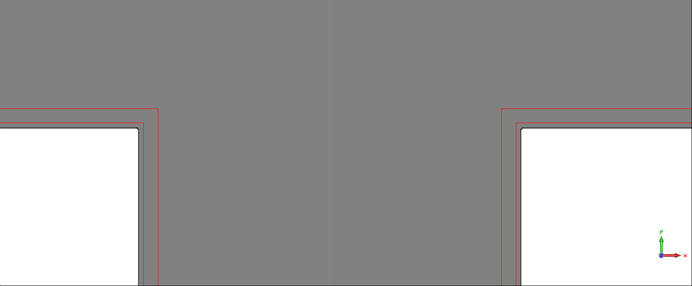
Simulation - Meshing

Slide 25
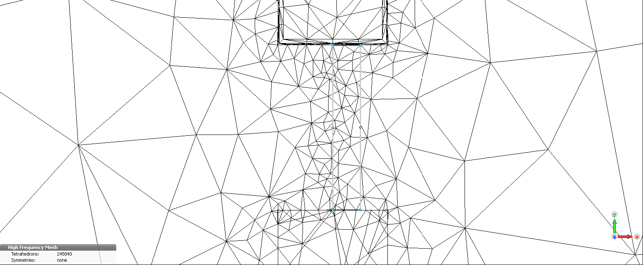
Simulation - Meshing

Slide 26
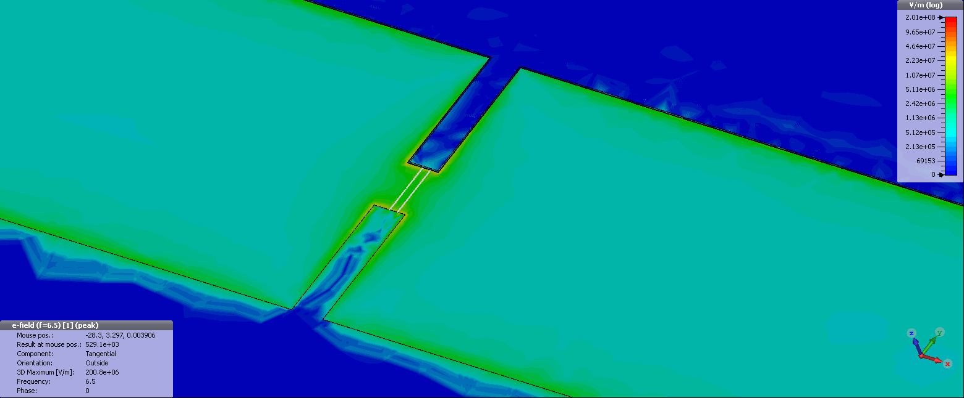
Simulation - Meshing

Slide 27
Simulation - Meshing
Simulating the ground plate as a thin sheet eliminates the need for very fine meshing in this area.
Edges of the ground sheet are provide minimal storage of energy compared to pad edges.

Slide 28
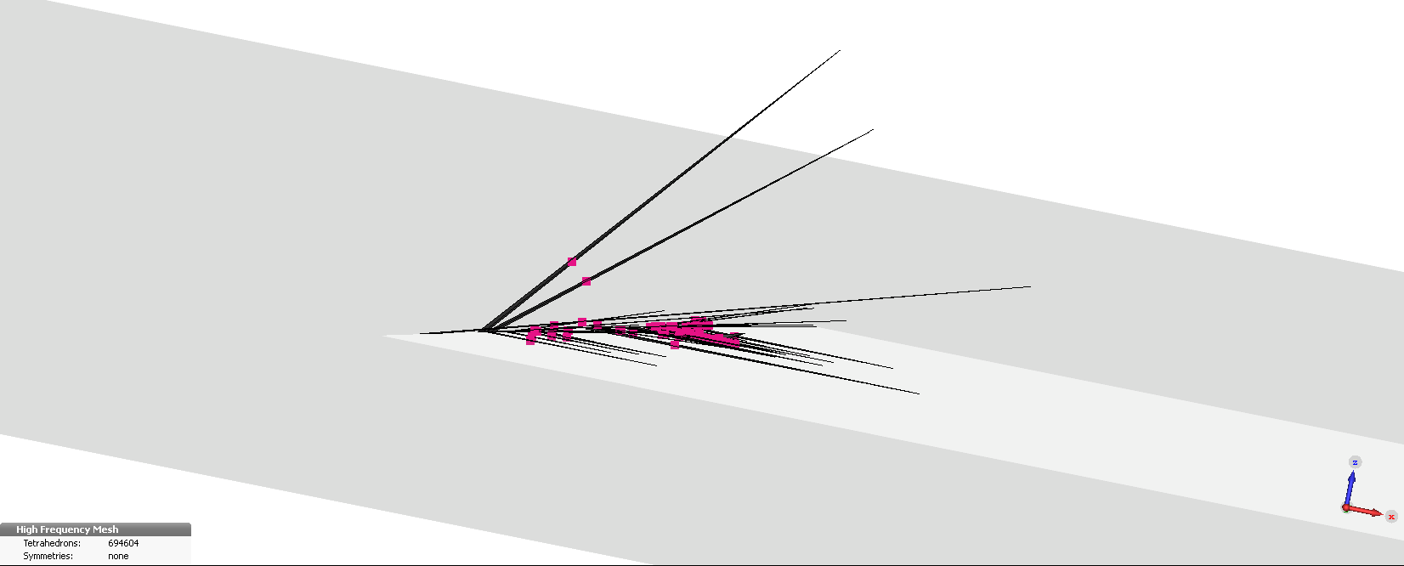
Simulation - Meshing

Slide 29
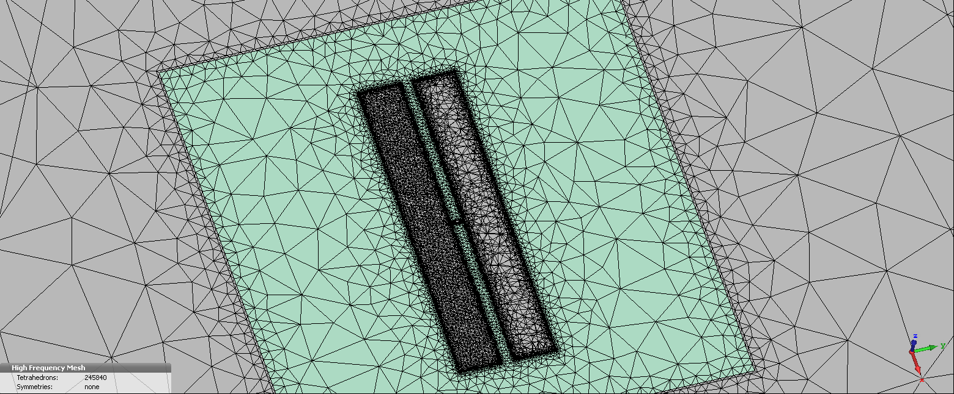
Simulation - Meshing

Slide 30
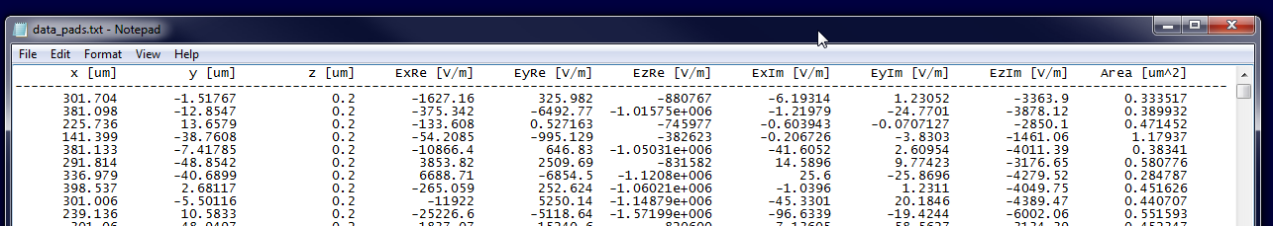
Post Processing
Export E-field data on different components (ground, substrate, pads) separately.

Slide 31
Post Processing
Separate data belonging to different lossy layers.
Separate normal and tangential component on SV-interface.
Evaluate given integral (summation in this case)

Slide 32
First Result - Ratio
IBM E-energy (MV) = 1.2299e-05 J E-energy (MS) = 1.9563e-04 J E-energy (SV) = 6.1201e-05 J p (MV) = 0.0457 p (MS) = 0.7269 p (SV) = 0.2274 | Yale E-energy (MV) = 6.4322e-05 J E-energy (MS) = 2.8180e-04 J E-energy (SV) = 1.4012e-04 J p (MV) = 0.1323 p (MS) = 0.5795 p (SV) = 0.2882

Slide 33
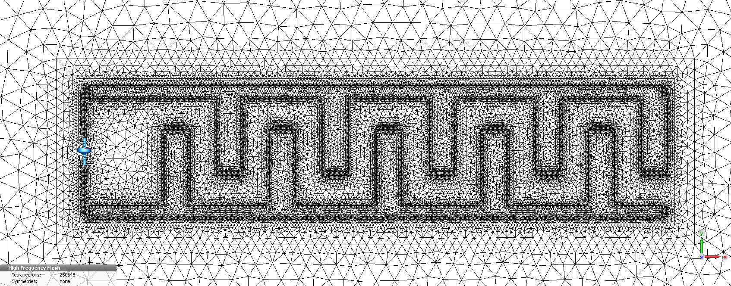
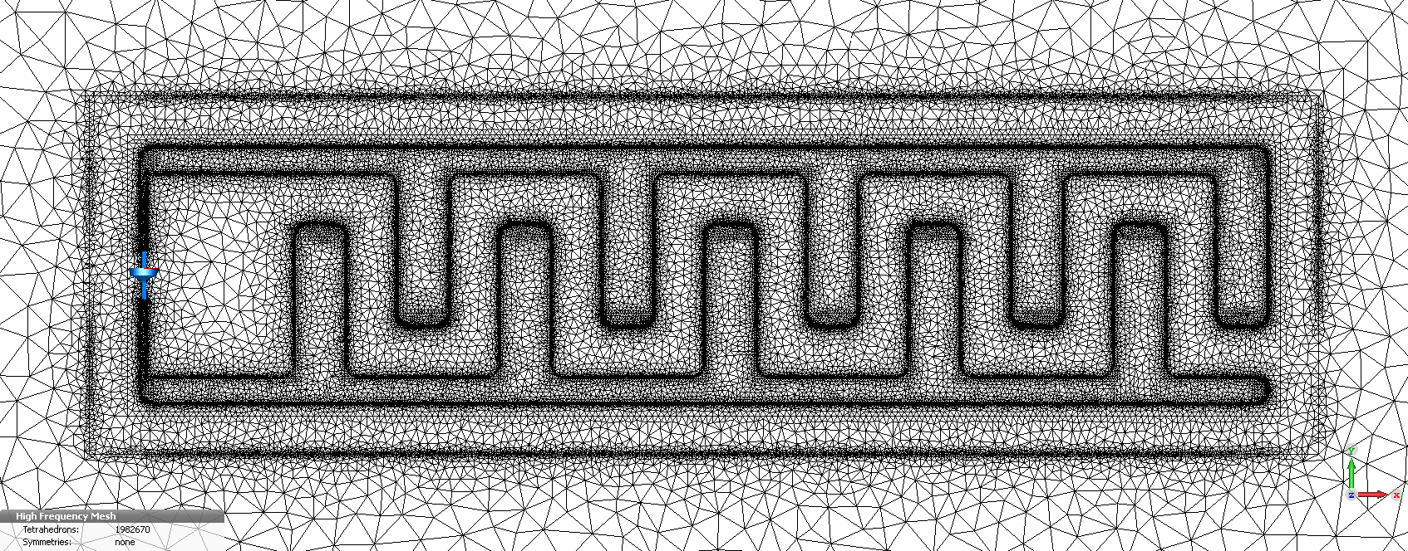
More pictures

Slide 34
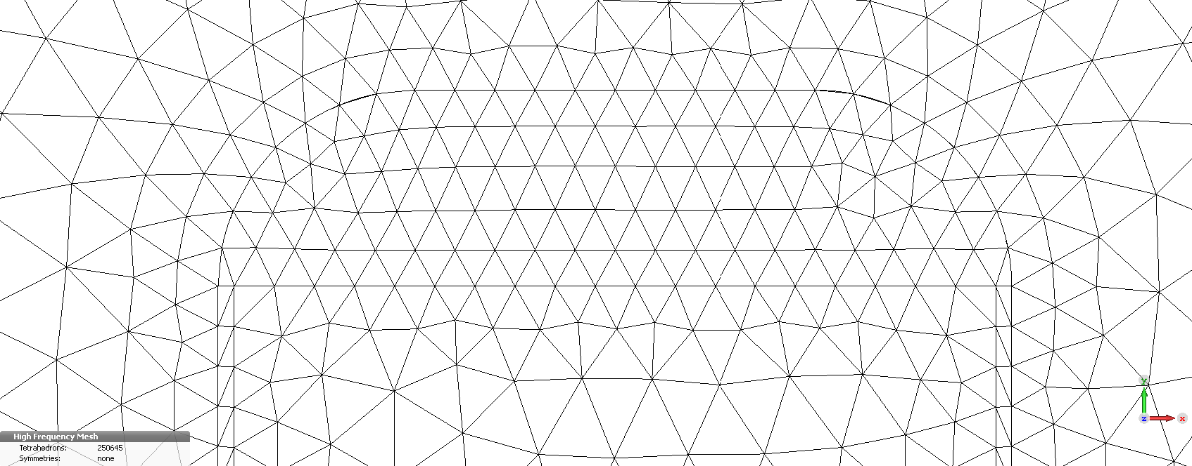
More pictures

Slide 35
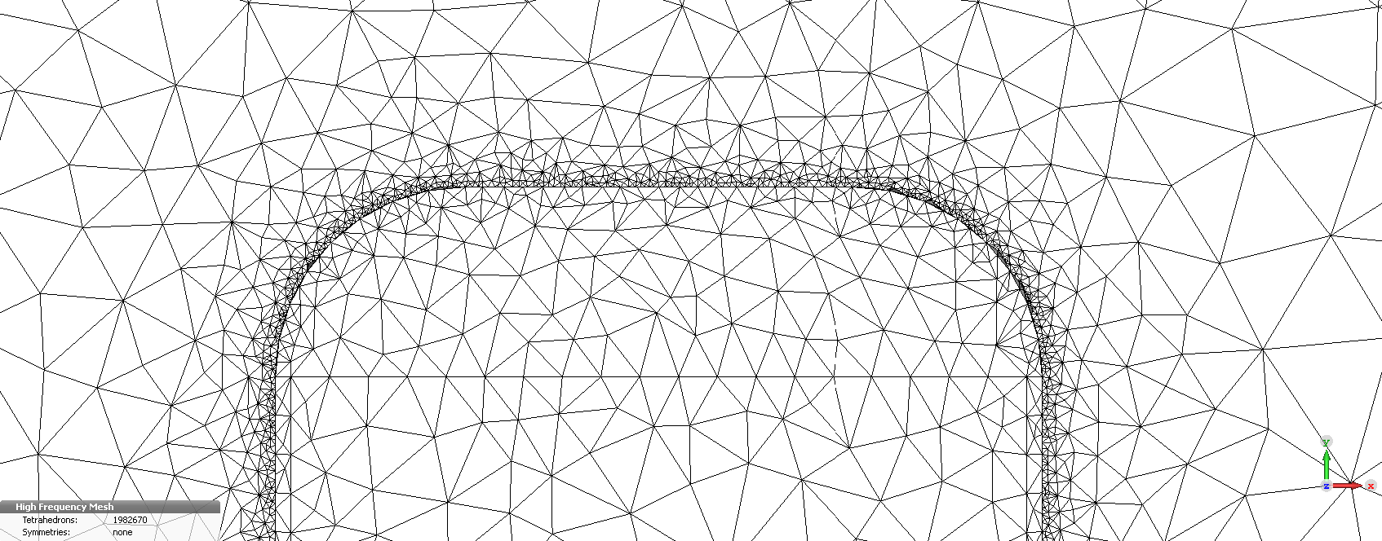
More pictures

Slide 36
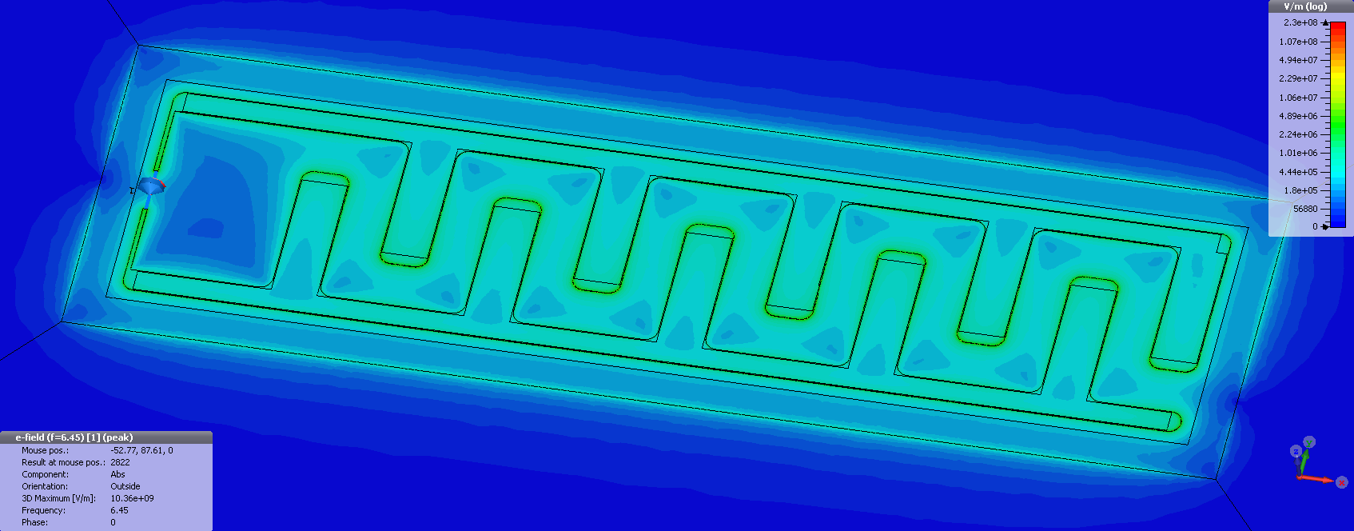
More pictures

Slide 37
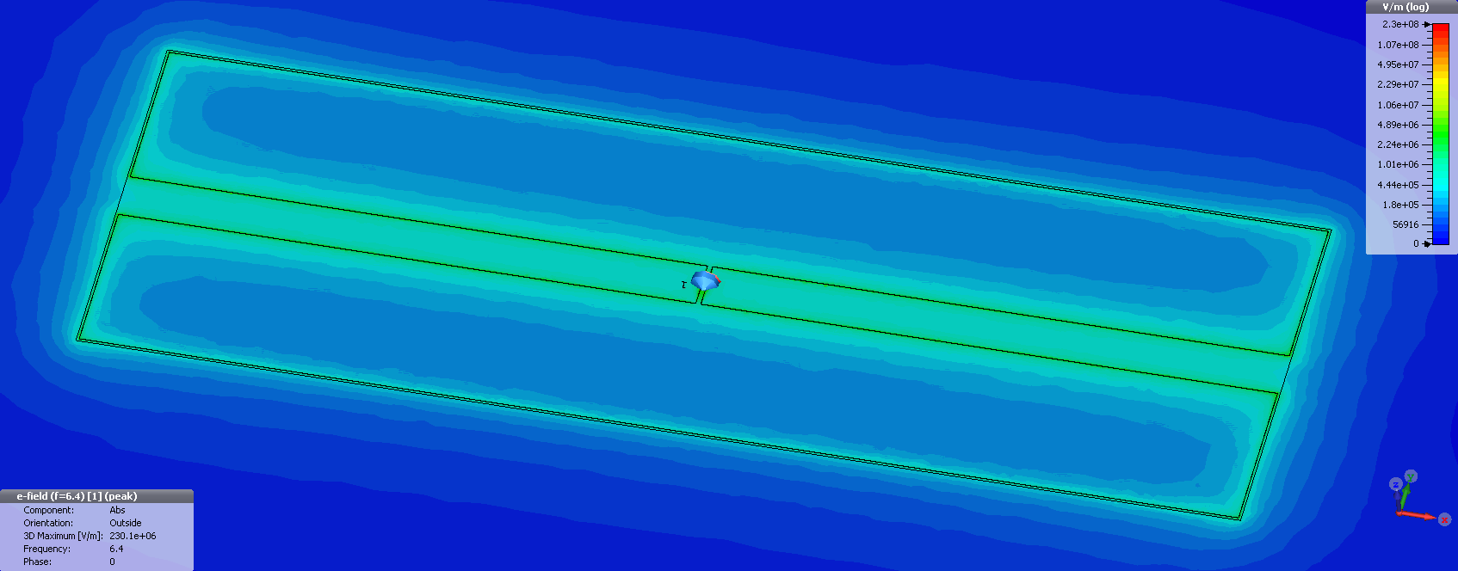
More pictures

